Slide 1
Welcome

Slide 2

Dr. J. J. Magdum College of,
Engineering, Jaysingpur.
Department of Computer Science and Engineering

Slide 3
Domain Specific Mini Project :-
Gym Website
-T.Y. B.Tech Mini Project

Slide 4
Project by-
Sr. No. | Students Name | Roll No.
1. | Tanmay Balu Patil | 39
2. | Shraddha Shrikant Salokhe | 45
3. | Reenal Chetan Shah | 46
4. | Sahil Sanjay Sutar | 49
5. | Pranav Jaywant Garud | 56
Under The Guidance of
-Prof. S. B. Farande

Slide 5
Contents
Sr. No. | Topic
1 | Abstract
2 | Introduction
3 | Problem Statement
4 | Literature Review
4 | Architecture Diagram
5 | Snapshots
6 | Software & Hardware Requirement
7 | Conclusion
8 | References

Slide 6
Abstract :-
The purpose of Gym Website is to automate the existing manual system by the help of computerized equipments and full-fledged computer website.
Customers can easily contact with us.
Our Gym management Software provides lots of functions such fees, plan, and physical fitness which help to provide good quality of services to customer from Gym managers.

Slide 7
Introduction :-
Our project is a website portal, that help users to join our fitness gym.
Users can select membership package according to their need and Sign up and log in the website.
Customer can check his updates online anytime about fitness or diet plan etc.
The focus of this project is about online services for a fitness club but by minimizing all those defects which are found in currently available manually file system.

Slide 8
Problem Statement :-
To Replace the cluttered design, poor navigation, and outdated content of the existing gym websites.

Slide 9
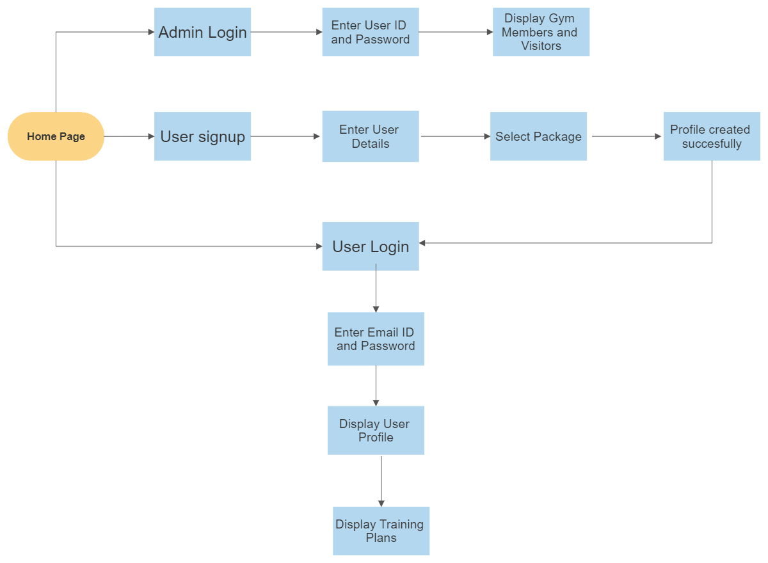
Architecture Diagram

Slide 10
Snapshots

Slide 11
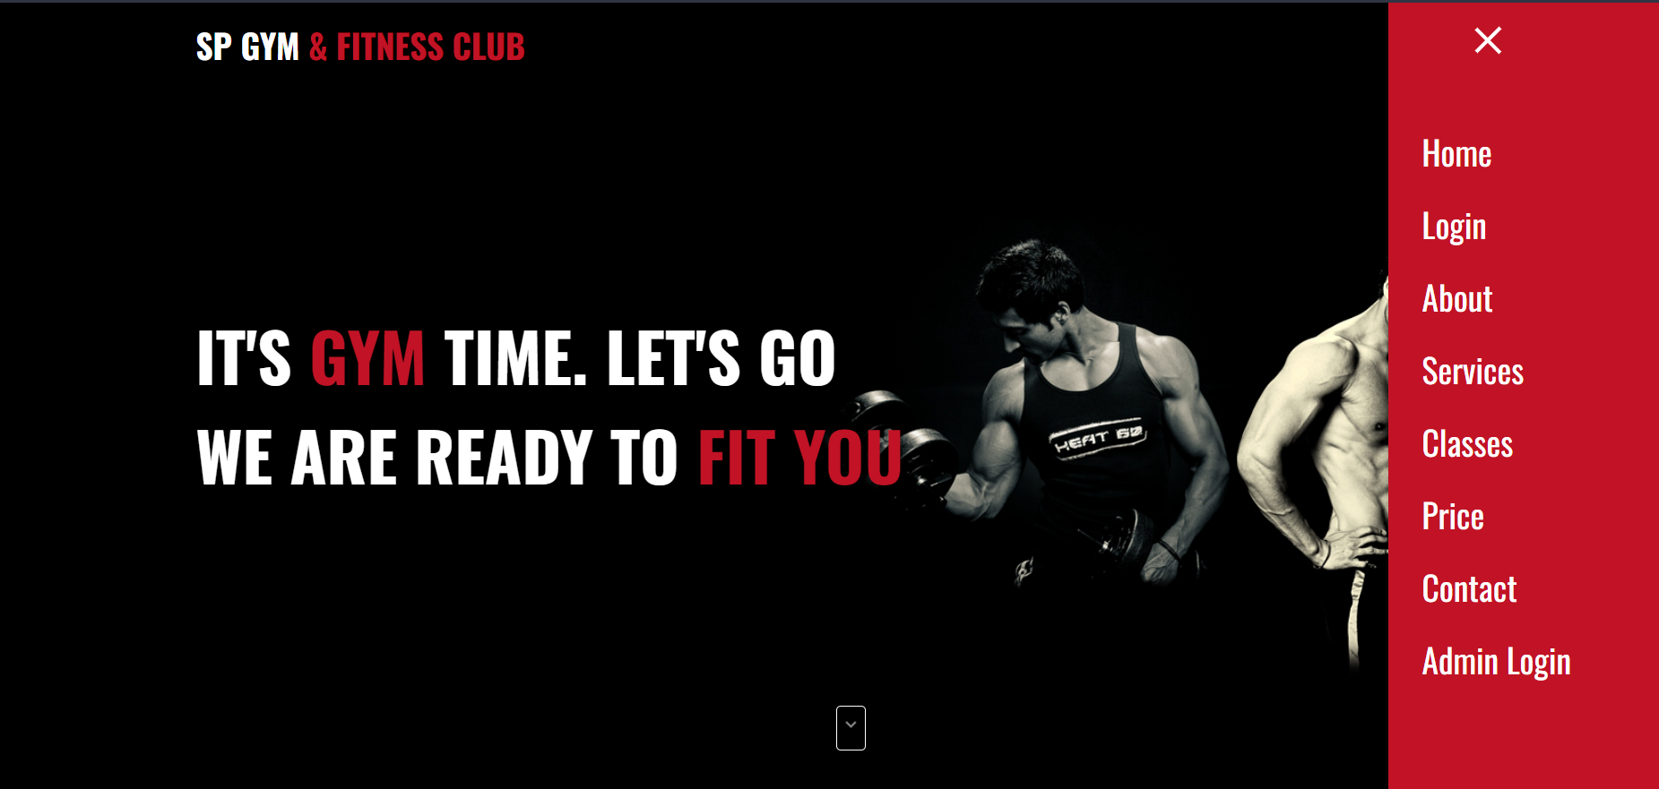
Home Page

Slide 12
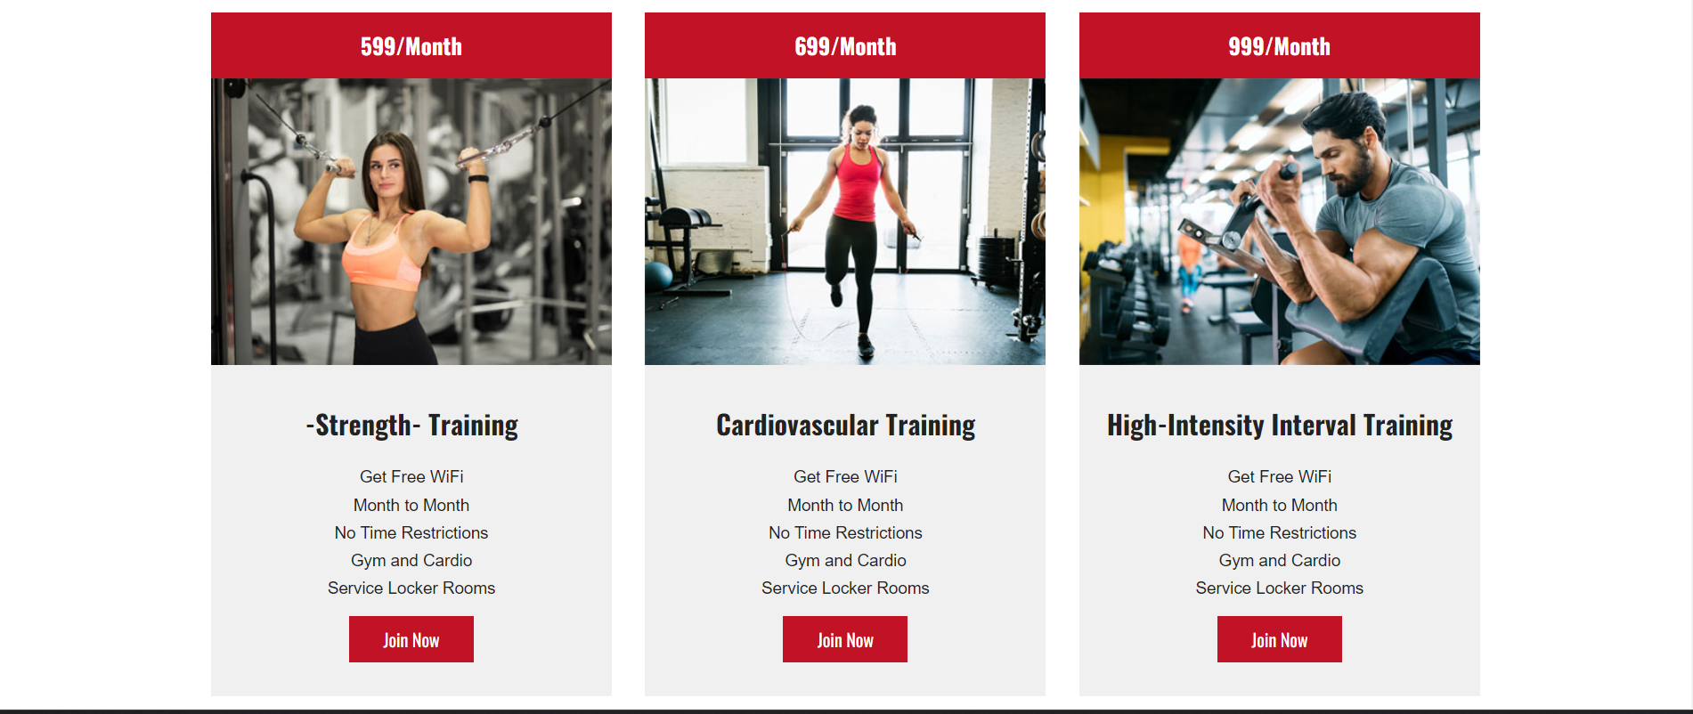
Choose Package

Slide 13
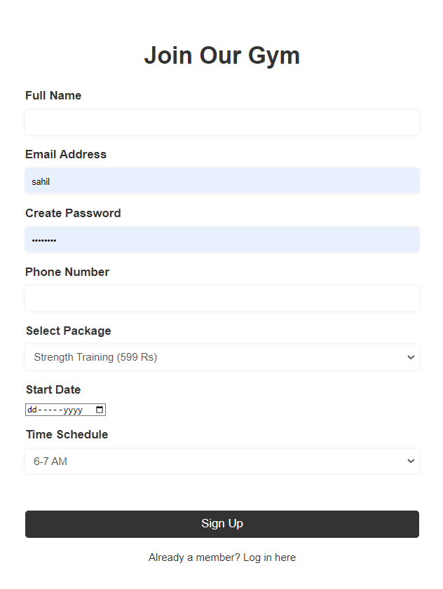
User Sign Up Page

Slide 14
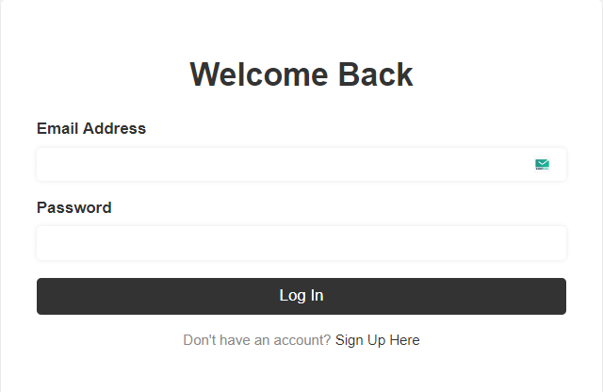
User Login Page

Slide 15
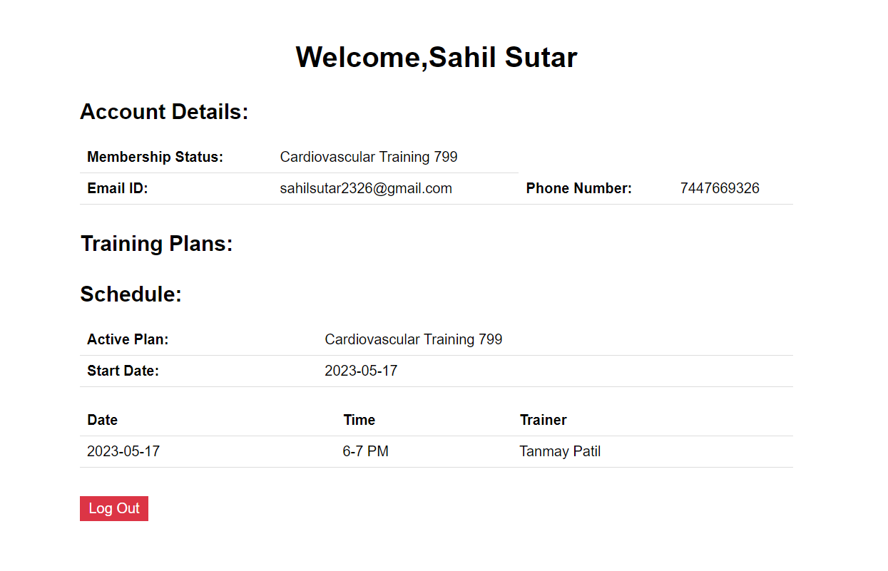
User Home Page

Slide 16
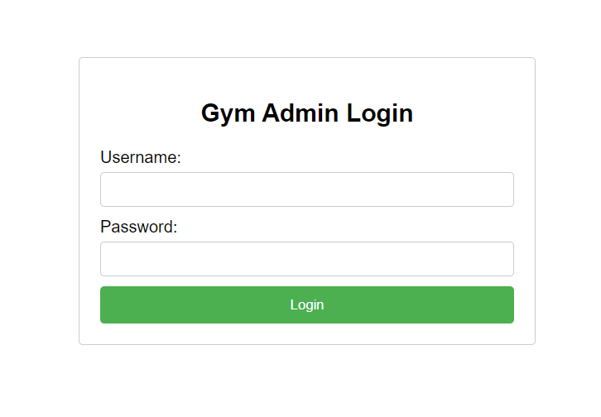
Admin Login Page

Slide 17
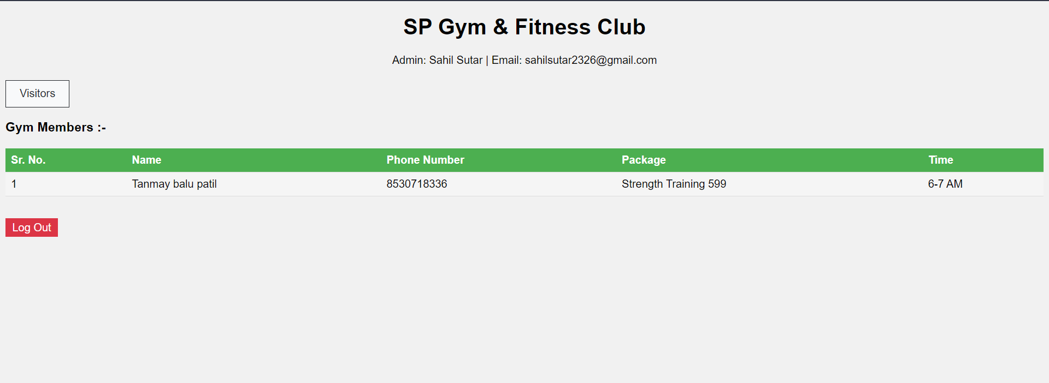
Admin Home Page

Slide 18
Software requirement: -
Operating system: Windows Operating System
Text editors: Visual Studio Code (Version 1.77.3)
Frontend Tools: HTML, CSS, JavaScript
Server: XAMPP(Apache)
Database : MySQL
Hardware requirements: -
Minimum 4 GB RAM
Minimum 100 GB HDD/SSD

Slide 19
Conclusion :-
Fitness website allows the user to join the fitness gym .This software package allows storing the details of all the data related to gymnasium . The implementation of the system will reduce the time as well as data entry

Slide 20
References: -
1.Choi Jillian Michaels, Mark Rippetoe (2018) examined the importance of website
design in engaging users on gym websites.
2. Joo Tony Horton, Al Kavadlo, Jen Sinkler (2019) explored the impact of social media integration on gym websites. The study found that incorporating social media into gym websites increased user engagement and generated more leads for gym owners.
3.Batacan, R. B., Duncan, M. J., & Dalbo, V. J. (2020) aims to provide a comprehensive understanding of gym management system.
4. Thompson, W. R., Gordon, N. F., & Pescatello, L. S. (Eds.) (2020) Discusses the key features of GMS, including membership management, scheduling and booking, and reporting.

Slide 21
Thank You

